Slide 1
DASC 5301-002
Variable Selection II
Dr Subharag Sarkar
Fall 2023
Slides Courtesy - Rózsa Záruba

Slide 2
Advantages of Selecting features
Improved accuracy
Simple models are easier to interpret.
Shorter training times
Enhanced generalization by reducing Overfitting
Easier to implement by software developers
Reduced risk of data errors by model use
Variable redundancy
Bad learning behavior in high dimensional spaces

Slide 3
Feature Selection – Techniques
Filter methods
Wrapper methods
Embedded methods

Slide 4
Filtered methods
Filter methods are generally used as a preprocessing step.
The selection of features is independent of any machine learning algorithms.
Instead, features are selected on the basis of their scores in various statistical tests for their correlation with the outcome variable.

Slide 5
Filtered methods
These methods rely on the characteristics of the data (feature characteristics)
They do not use machine learning algorithms.
They tend to be less computationally expensive.
They usually give lower prediction performance than wrapper methods.
They are very well suited for a quick screen and removal of irrelevant features.

Slide 6
Filtered methods
Basic methods (remove constant and quasi-constant features)
Univariate feature selection (SelectKBest, SelectPercentile)
Information gain (mutual information)
Fischer score (chi-square implementation)
ANOVA F-Value for Feature Selection (ANOVA F-value)
Correlation Matrix with Heatmap

Slide 7
Wrapper Methods
In wrapper methods, we try to use a subset of features and train a model using them.
Based on the inferences that we draw from the previous model, we decide to add or remove features from the subset.
The problem is essentially reduced to a search problem.
These methods are usually computationally very expensive.

Slide 8
Wrapper Methods
Forward selection
Backward elimination
Exhaustive feature selection
Recursive feature elimination
Recursive feature elimination with cross-validation

Slide 9
Forward vs Backward
Forward Stepwise
Backward Stepwise
It can be used when the number of variables under consideration is very large, even larger than the sample size
Favors smaller models (fewer variables)
Starting with the full model, it has the advantage of considering the effects of all variables simultaneously.
Favors larger number of variables.
Best of both worlds: use forward-backward selection, where you alternate adding and removing a variable till you reach your best model
Unless the number of candidate variables > sample size (or number of events), use a backward stepwise approach.
Notes:
This is especially important in case of collinearity (when variables in a model are correlated which each other) because backward stepwise may be forced to keep them all in the model unlike forward selection where none of them might be entered

Slide 10
Advantages of stepwise selection:
It is easy to apply
It improves model generalizability
It yields a simple model that is easy to interpret
It is objective and reproducible

Slide 11
Notes on stepwise selection
Stepwise selection provides a reproducible and objective way to reduce the number of predictors compared to manually choosing variables based on expert opinion which, more often than we would like to admit, is biased towards proving one’s own hypothesis.
Note however, that automated variable selection is not meant to replace expert opinion. In fact, important variables judged by background knowledge should still be entered in the model even if they are statistically non-significant.
Where automated variable selection is most helpful is in exploratory data analysis especially when working on new problems not already studied by other researchers (where background knowledge is not available).

Slide 12
Limitations of stepwise selection:
It does not consider all possible combination of potential predictors
It produces an unstable selection of variables
It does not consider the causal relationship between variables

Slide 13
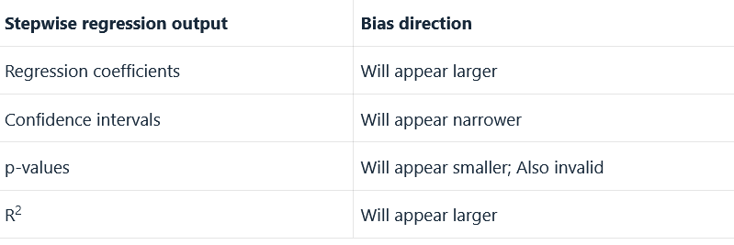
Limitations of stepwise selection:
It outputs biased regression coefficients, confidence intervals, p-values, and R2

Slide 14
Exhaustive Feature Selection
In an exhaustive feature selection the best subset of features is selected, over all possible feature subsets, by optimizing a specified performance metric for a certain machine learning algorithm.
For example, if the classifier is a logistic regression and the dataset consists of 4 features, the algorithm will evaluate all 15 feature combinations as follows:
all possible combinations of 1 feature
all possible combinations of 2 features
all possible combinations of 3 features
all the 4 features
and select the one that results in the best performance (e.g., classification accuracy).
This is another greedy algorithm as it evaluates all possible feature combinations.
It is quite computationally expensive, and sometimes, if feature space is big, even unfeasible.

Slide 15
Recursive Feature elimination
Recursive feature elimination performs a greedy search to find the best performing feature subset.
It iteratively creates models and determines the best or the worst performing feature at each iteration.
It constructs the subsequent models with the left features until all the features are explored.
It then ranks the features based on the order of their elimination.
In the worst case, if a dataset contains N number of features RFE will do a greedy search for 2N combinations of features.

Slide 16
Recursive Feature Elimination with Cross-Validation
Recursive Feature Elimination with Cross-Validated (RFECV)
This feature selection technique selects the best subset of features for the estimator by removing 0 to N features iteratively using recursive feature elimination.
Then it selects the best subset based on the accuracy or cross-validation score or roc-auc of the model.

Slide 17
There is a special package for python that implements these feature selections:
mlxtend

Slide 18
Embedded Methods

Slide 19
Embedded Methods
Embedded methods are iterative in a sense that takes care of each iteration of the model training process and carefully extract those features which contribute the most to the training for a particular iteration.
Regularization methods are the most commonly used embedded methods which penalize a feature given a coefficient threshold.
Regularization methods are also called penalization methods that introduce additional constraints into the optimization of a predictive algorithm (such as a regression algorithm) that bias the model toward lower complexity (fewer coefficients).
Some of the most popular examples of these methods are LASSO, RIDGE regression and Elastic Net, which have inbuilt penalization functions to reduce overfitting.

Slide 20
Embedded Methods
Some of the most popular examples of these methods are:
LASSO
RIDGE regression
Elastic Net, which have inbuilt penalization functions to reduce overfitting.

Slide 21
RIDGE Regression
Ridge regression is a method of estimating the coefficients of multiple-regression models in scenarios where linearly independent variables are highly correlated.
It provides a more precise ridge parameters estimate, as its variance and mean square estimator are often smaller than the least square estimators previously derived.

Slide 22
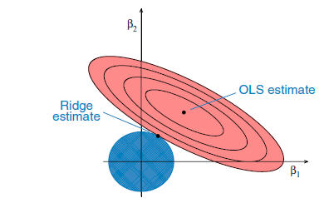
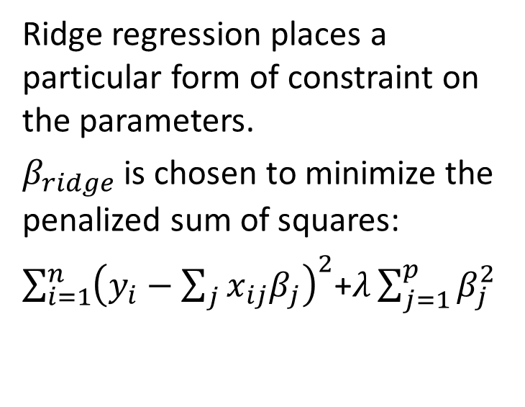
RIDGE Regression
Ridge regression places a particular form of constraint on the parameters.
$β_{ridge}$ is chosen to minimize the penalized sum of squares:
$\sum_{i=1}^{n}{{\left(y_{i}−\sum_{j}{x_{ij}β_{j}}\right)}^{2}}$+$λ\sum_{j=1}^{p}{β_{j}^{2}}$
The ellipses correspond to the contours of residual sum of squares (RSS): the inner ellipse has smaller RSS, and RSS is minimized at ordinal least square (OLS) estimates.
We are trying to minimize the ellipse size and circle simultaneously in the ridge regression. The ridge estimate is given by the point at which the ellipse and the circle touch.

Slide 23

RIDGE Regression
There is a trade-off between the penalty term and RSS.
Maybe a large beta would give you a better residual sum of squares but then it will push the penalty term higher.
This is why you might actually prefer smaller betas with worse residual sum of squares.
From an optimization perspective, the penalty term is equivalent to a constraint on the betas.
The function is still the residual sum of squares but now you constrain the norm of the $β_{j}$ 's to be smaller than some constant c.
There is a correspondence between λ and c. The larger the λ is, the more you prefer the $β_{j}$'s close to zero. In the extreme case when λ=0, then you would simply be doing a normal linear regression. And the other extreme as λ approaches infinity, you set all the betas's to zero.

Slide 24
LASSO Regression
Lasso regression is a type of linear regression that uses shrinkage.
Shrinkage is where data values are shrunk towards a central point, like the mean.
The lasso procedure encourages simple, sparse models (i.e. models with fewer parameters).
This particular type of regression is well-suited for models showing high levels of muticollinearity or when you want to automate certain parts of model selection, like variable selection/parameter elimination.
The acronym “LASSO” stands for Least Absolute Shrinkage and Selection Operator.

Slide 25
LASSO Regression
Lasso regression performs L1 regularization which adds penalty equivalent to absolute value of the magnitude of coefficients.
Regularization consists in adding a penalty to the different parameters of the machine learning model to reduce the freedom of the model and in other words to avoid overfitting.
In linear model regularization, the penalty is applied over the coefficients that multiply each of the predictors.
From the different types of regularization, Lasso or l1 has the property that is able to shrink some of the coefficients to zero.
Therefore, that feature can be removed from the model.

Slide 26
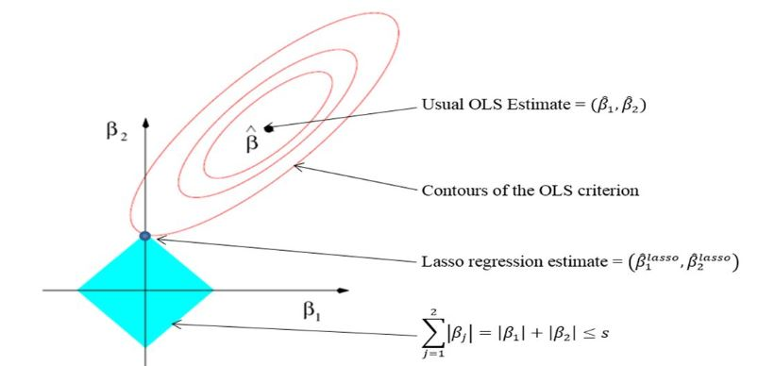
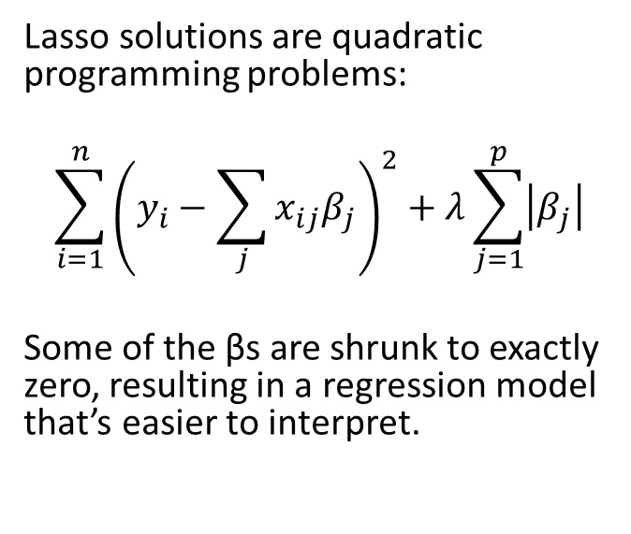
LASSO Regression
Lasso solutions are quadratic programming problems:
$$\sum_{i=1}^{n}{{\left(y_{i}−\sum_{j}{x_{ij}β_{j}}\right)}^{2}+λ\sum_{j=1}^{p}{\left|β_{j}\right|}}$$
Some of the βs are shrunk to exactly zero, resulting in a regression model that’s easier to interpret.

Slide 27
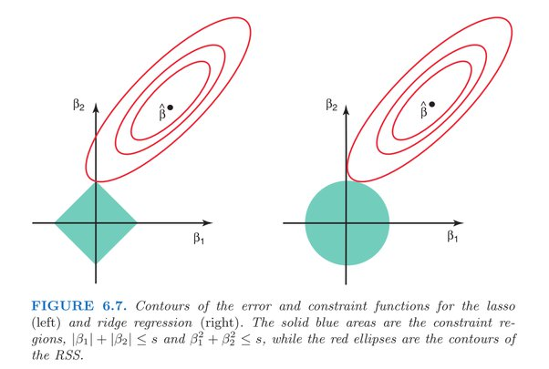
LASSO vs RIDGE Regression
As the caption notes, the blue diamond and blue circle regions represent the constraints used in Lasso and Ridge regression, respectively. The β-hat in the image represents the least-squares solution without the lasso or ridge constraints. Each ellipse represents constant residual sum-of-squares (RSS) value, the equation being minimized in regression. The further the ellipse is from β-hat, the larger the RSS. Therefore to minimize RSS subject to a Lasso or Ridge constraint, the coefficient estimates are given by the first point of intersection between an ellipse and a constraint region.
Because the Ridge constraint is circular, the first point of contact with an RSS ellipse is usually not exactly at an axis, where a coefficient is set to 0. The Lasso constraint, on the other hand, has a corner at each axis, increasing the likelihood that the first point of contact with an RSS ellipse will occur at an axis, thus providing a solution where a coefficient is set to 0.
Reference: Gareth James, Daniela Witten, Trevor Hastie, Robert Tibshirani. An Introduction to Statistical Learning: with Applications in R. New York: Springer, 2013.

Slide 28
LASSO Regression
A tuning parameter, λ controls the strength of the L1 penalty. λ is basically the amount of shrinkage:
When λ = 0, no parameters are eliminated. The estimate is equal to the one found with linear regression.
As λ increases, more and more coefficients are set to zero and eliminated (theoretically, when λ = ∞, all coefficients are eliminated).
As λ increases, bias increases.
As λ decreases, variance increases.

Slide 29
Ridge vs Lasso
Ridge regression: helps when variables are correlated but cannot perform variable selection.
LASSO: helps with variable selection, but it is not stable when variables are correlated.
What should we do to get the benefits from both?

Slide 30
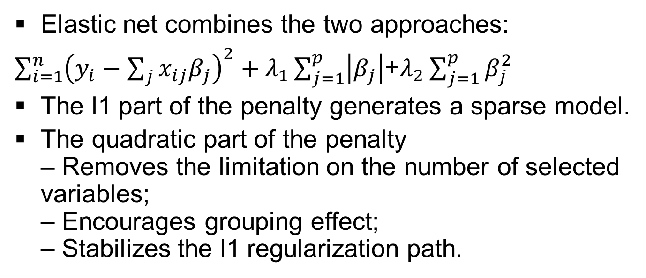
Elastic Net
Elastic net combines the two approaches:
$\sum_{i=1}^{n}{{\left(y_{i}−\sum_{j}{x_{ij}β_{j}}\right)}^{2}+λ_{1}\sum_{j=1}^{p}{\left|β_{j}\right|}}$+$λ_{2}\sum_{j=1}^{p}{β_{j}^{2}}$
The l1 part of the penalty generates a sparse model.
The quadratic part of the penalty – Removes the limitation on the number of selected variables; – Encourages grouping effect; – Stabilizes the l1 regularization path.

Slide 31
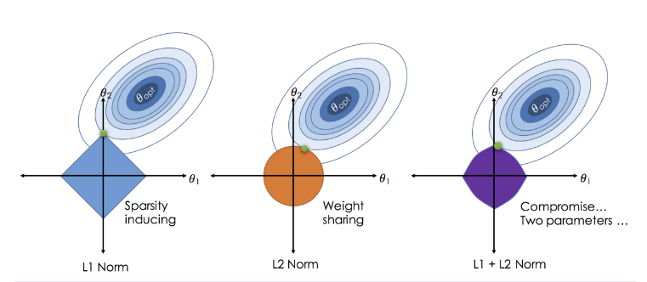

Slide 32
Reference material
https://scikit-learn.org/stable/modules/feature_selection.html
https://scikit-learn.org/stable/modules/generated/sklearn.feature_selection.mutual_info_classif.html#sklearn.feature_selection.mutual_info_classif
https://scikit-learn.org/stable/modules/generated/sklearn.feature_selection.mutual_info_regression.html#sklearn.feature_selection.mutual_info_regression
https://online.stat.psu.edu/stat857/node/155/
https://www.geeksforgeeks.org/implementation-of-lasso-ridge-and-elastic-net/

